Slide 1
Project group: 22
Ansari Faiz 14CO17
Khan Khalid 16DCO54
Shaikh Azamali 17DCO75
Project Guide:
Prof. Mukhtar Ansari
DFROM – Detecting Fake Reviews using Opinion Mining.

Slide 2
Overview
Digital marketing is booming, in today’s lifeline online business in mainly dependent on review and rating of particular product.
Seller or product owner post fake reviews to increase their product’s ratings or to demotivate their opposition’s products.
Our system is mainly focuses on movies reviews & rating, we are going to perform operations on movies reviews.
We will get the dataset from IMDb website.

Slide 3
Literature Summary.
Features/Papers | Android Application | Text Classification | SVM Algorithm | operation on actual data | Detection Of movie reviews | Result Storage | Web Application
Paper 1 | NO | YES | YES | NO | NO | NO | YES
Paper 2 | NO | YES | NO | NO | NO | NO | YES
Paper 3 | NO | YES | YES | NO | YES | NO | YES
Our System | YES | YES | YES | YES | YES | YES | YES

Slide 4
Problem statement.
Online reviews carry information which helps users in decision making. To promote or lower the quality of the product spammer may produce fake reviews.
Thus detecting fake reviews is a significant problem.
Opinion mining helps in detecting positive or negative opinions.

Slide 5
Objectives.
To implement algorithm to get better Spam Detection i.e. Account used, polarity of words using textblob, negativity and positivity of content, etc.
To presents Opinion Mining on Spam Filtered Data.
To demonstrate the difference between the actual rating of the movie and the calculated resultant rating of the same.

Slide 6
Scope.
Our project is to build the system that can identify and distinguish between fake reviews and genuine reviews,
Our project will be working on machine learning algorithms that will do the good work of detecting reviews and identify reviews.
Our system is build on top of machine learning, python libraries and using algorithms our system works almost accurately.
The dataset we are importing is directly from IMDB website so the data are totally user based, unlike free datasets available on internet this dataset is completely on user’s demand so the evaluation will work on real data.

Slide 7
Proposed System.
To tackle this problem we came up with the idea of detecting those fake (spam) reviews.
Our proposed system which is DFROM works with Sentiment Analysis (SA) and is built on top of machine learning algorithms like Support Vector Machine (SVM).
Dataset on which we will perform our operation is extracted from IMDb website.

Slide 8
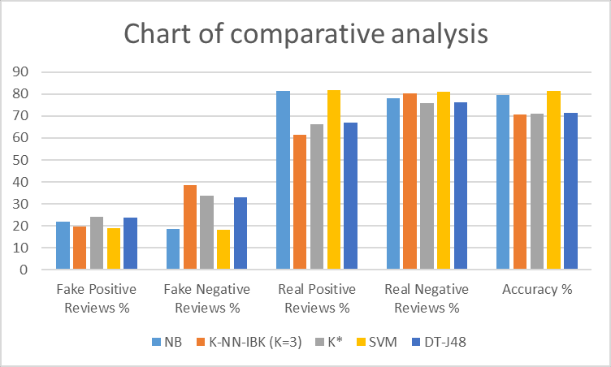
Why SVM?

Slide 9
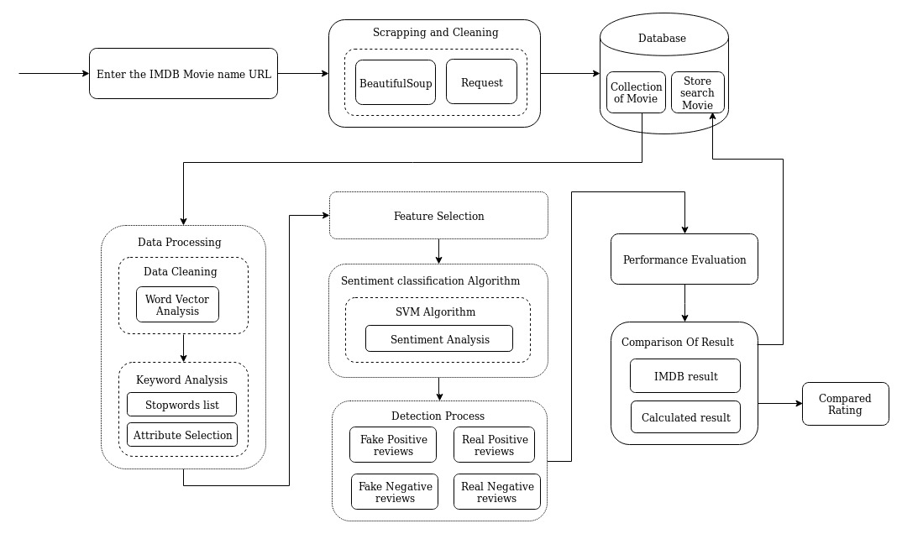
System Architechture.

Slide 10
Analysis/Framework/Algorithm
Dataset Scrapping.
Datasets will be extracted from movies reviewing websites like IMDB by dbmovies API.
Datasets can be scrapped by using Beautifulsoup liberary(optional).
Detection Process.
Applying SVM algorithm on processed data.
0-Positive 1-Negative
Data Processing.
Pre-processing of reviews.
Discarding stopwords as they don’t share much polarity.
Converting sentence into vectors, data is divided into tokens.
Result Evaluation.
Display result to user and compare the Computed data to the originally retrieved data.

Slide 11
Hardware & Software used.
Server Side Hardware used
Core i5 5th gen Processor
Ram (16 GB)
Storage 2TB
Internet Connection
Client Side Hardware used
Intel Core i3 3 rd gen processor or any equivalent (For Desktop).
Qualcomm snapdragon 400 series or any equivalent (For mobile).
4 GB RAM & Disk Space (for Desktop)/ 2 GB RAM & Disk Space (for Mobile)
Server side Software Used
Ubuntu 18.04 LTS or later/ MAC OS 10.1 or later.
HTML 5 compatible Browser
Apache server
Client Side Software used
Microsoft Windows XP or later / Ubuntu 12.0 LTS or later/ MAC OS 10.1 or later/Android jellybean or later (For Mobile)
Browser

Slide 12
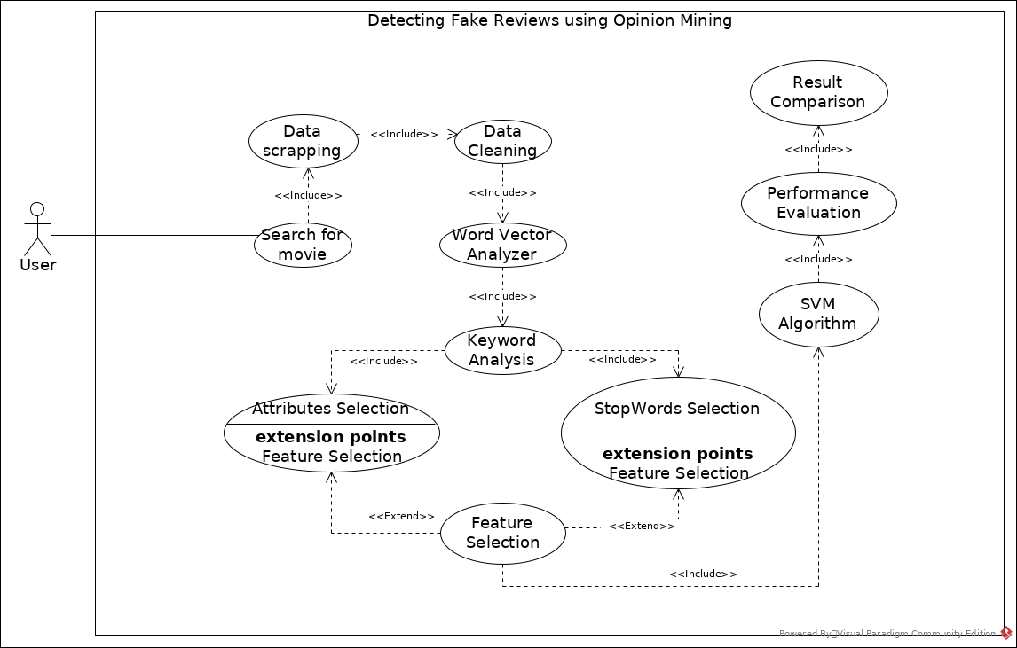
UseCase Diagram.

Slide 13
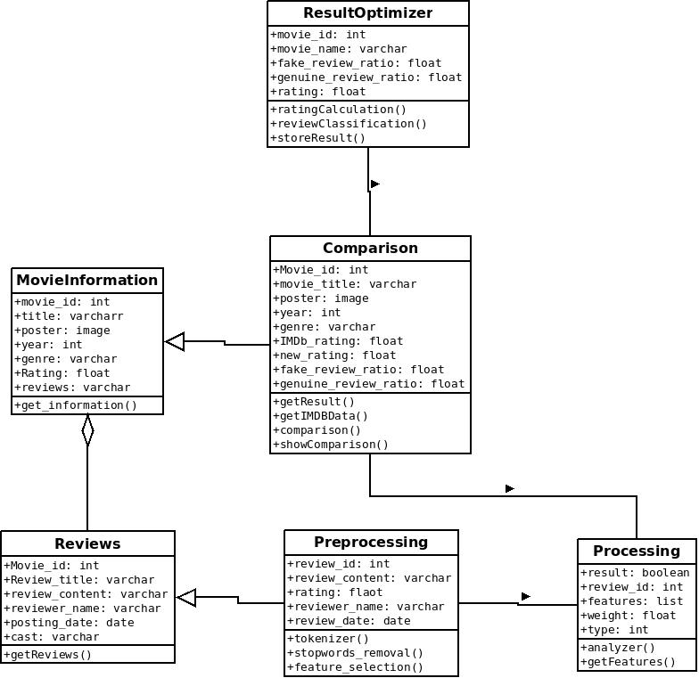
Class Diagram.

Slide 14
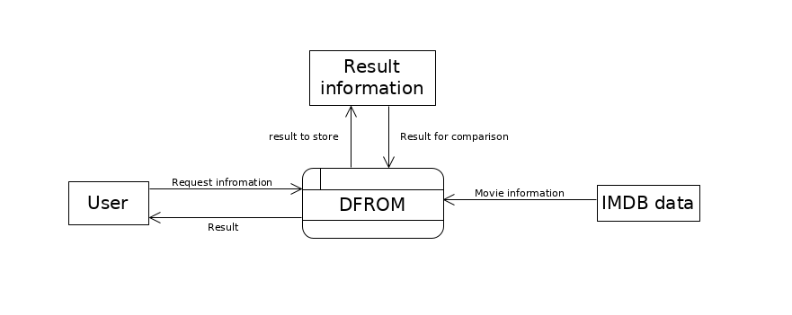
DFD (Level 0)

Slide 15
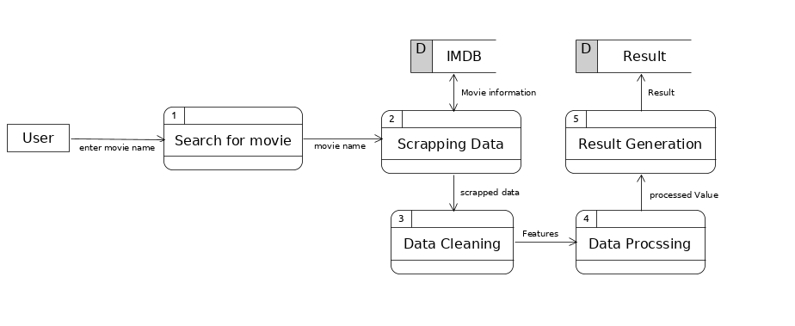
DFD (Level 1)

Slide 16
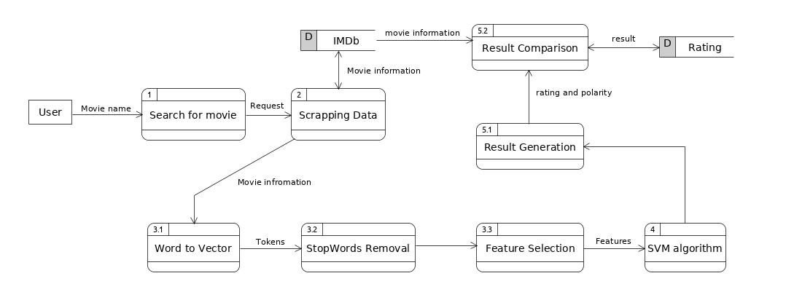
DFD (Level 2)

Slide 17
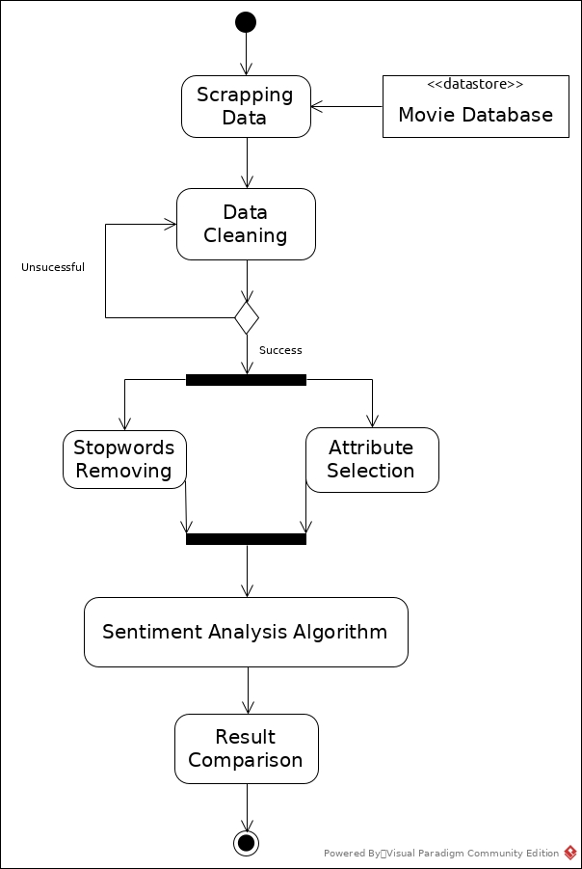
Activity Diagram.

Slide 18
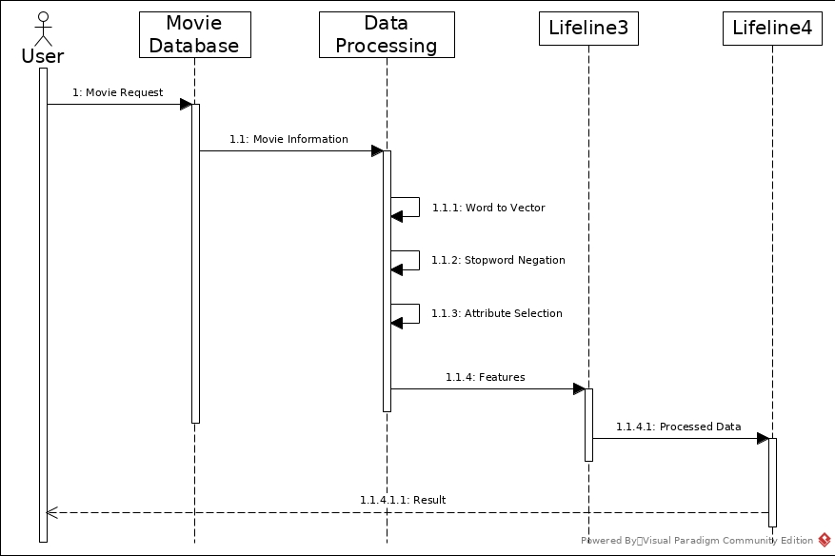
Sequence Diagram.

Slide 19
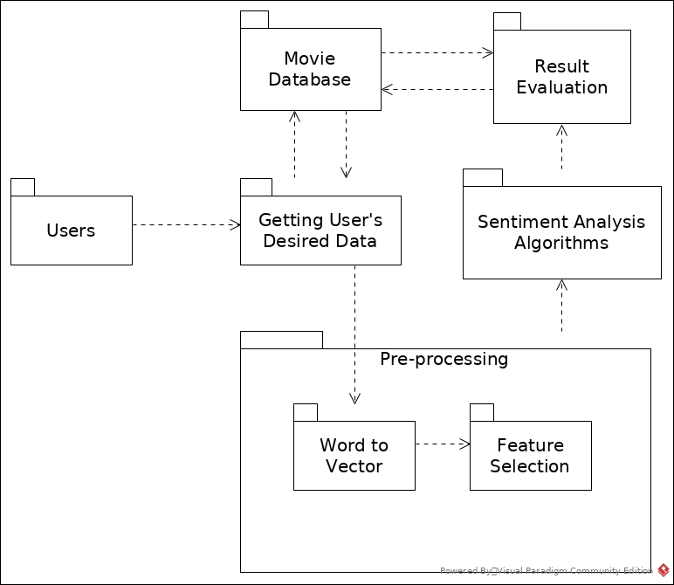
Module Diagram

Slide 20
Conclusion.
we have used Requests and BeautifulSoup which is python libraries for data scrapping to get the data from IMDB website and successfully store the data as per next module requirement using pandas library.

Slide 21
Reference.
Elshrif Elmurngi, Abdelouahed Gherbi; An empirical study on detecting fake reviews using machine learning techniques; Conference Paper · August 2017
June 2018 ; Elshrif Elmurngi, Abdelouahed Gherbi; Detecting Fake Reviews through Sentiment Analysis Using Machine Learning Techniques Conference Paper
Neha S. Chowdhary, Anala A. Pandit; Fake review Detection using Classification; June 2018

